Slide 1
SENG2260 Human-Computer Interaction
Week 6: Usability testing
All images in this presentation are either licenced or labelled for reuse on Google Images.

Slide 2

Lecture Aims
To consider what usability testing is
Outline the basics of experimental design
Describe how to do field studies

Slide 3


Chapter 6
Evaluation Studies: From Controlled to Natural Settings
Chapter 15
Evaluation Studies: From Controlled to Natural Settings

Slide 4
Usability testing
Involves recording performance of typical users doing typical tasks.
Controlled settings.
Users are observed and timed.
Data is recorded on video & key presses are logged.
The data is used to calculate performance times, and to identify & explain errors.
User satisfaction is evaluated using questionnaires & interviews.
Field observations may be used to provide contextual understanding.
Notes:
4

Slide 5
Experiments & usability testing
Experiments test hypotheses to discover new knowledge by investigating the relationship between two or more variables.
Usability testing is applied experimentation.
Developers check that the system is usable by the intended user population for their tasks.
Notes:
5

Slide 6
Usability testing & research
Usability testing
Improve products
Few participants
Results inform design
Usually not completely replicable
Conditions controlled as much as possible
Procedure planned
Results reported to developers
Experiments for research
Discover knowledge
Many participants
Results validated statistically
Must be replicable
Strongly controlled conditions
Experimental design
Scientific report to scientific community
Notes:
6

Slide 7
Usability testing
Goals & questions focus on how well users perform tasks with the product.
Comparison of products or prototypes is common.
Focus is on time to complete task & number & type of errors.
Data collected by video & interaction logging.
Testing is central.
User satisfaction questionnaires & interviews provide data about users’ opinions.
Notes:
7

Slide 8

Testing conditions
Usability lab or other controlled space.
Emphasis on:
selecting representative users;
developing representative tasks.
5-10 users typically selected.
Tasks usually around 30 minutes
Test conditions are the same for every participant.
Informed consent form explains procedures and deals with ethical issues.
Notes:
8

Slide 9

Types of data
Time to complete a task.
Time to complete a task after a specified time away from the product.
Number and type of errors per task.
Number of errors per unit of time.
Number of times online help and manuals accessed.
Number of users making an error.
Number of users successfully completing a task.
Notes:
9

Slide 10
How many participants is enough for user testing?
The number is a practical issue.
Depends on:
schedule for testing;
availability of participants;
cost of running tests.
Typically 5-10 participants.
Some experts argue that testing should continue until no new insights are gained.
Notes:
10

Slide 11
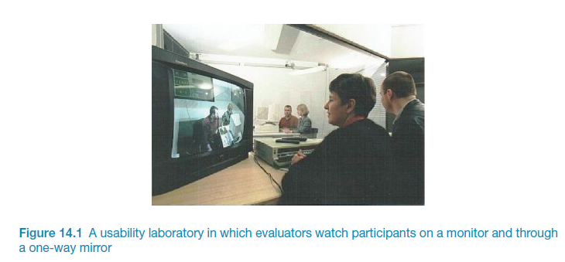
Usability lab with observers watching a user & assistant

Slide 12
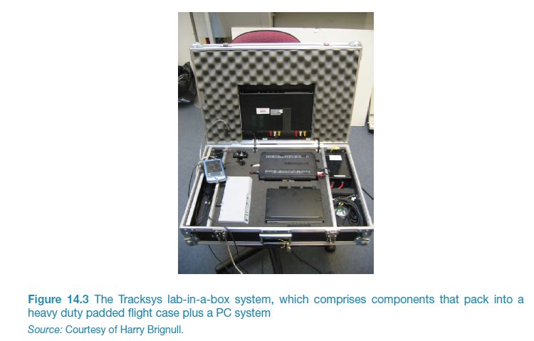
Portable equipment for use in the field

Slide 13
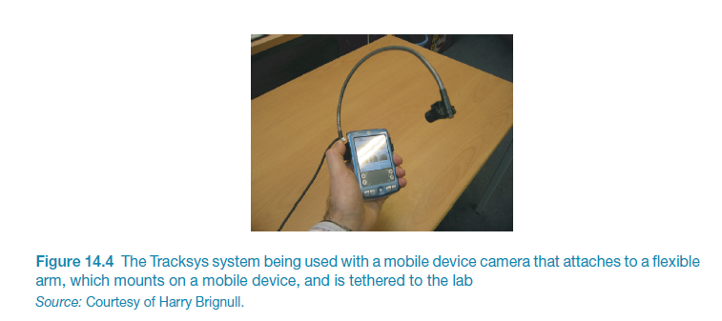
Portable equipment for use in the field

Slide 14
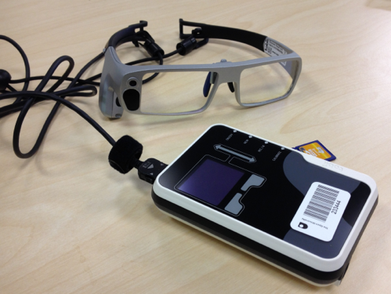
Tobii Glasses Mobile Eye-Tracking System
Source: Dalton et al., 2015, p.3891. Reproduced with permission of ACM Publications

Slide 15
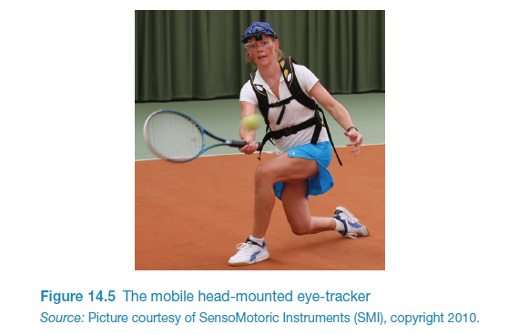
Mobile head-mounted eye tracker

Slide 16
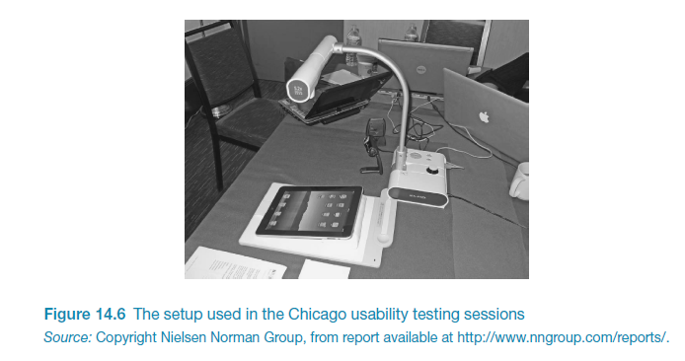
Example of the equipment

Slide 17
Testing the iPad usability
First study was conducted quickly in two cities: Fremont, CA and Chicago
Tests had to be done quickly as information was needed by 3rd party app developers
Also needed to be secretly so that the competition was not aware before the iPad was launched.
7 participants with 3+ months experience with iPhones
Signed an informed consent form explaining:
what the participant would be asked to do;
the length of time needed for the study;
the compensation that would be offered for participating;
participants’ right to withdraw from the study at any time;
a promise that the person’s identity would not be disclosed; and
an agreement that the data collected would be confidential and would be available to only the evaluators
Then they were asked to explore the iPad
Next they were asked to perform randomly assigned specified tasks

Slide 18
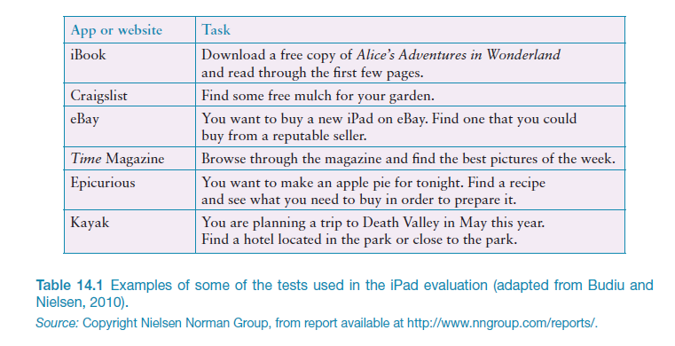
Examples of the tasks

Slide 19
Problems and actions
Problems detected:
Accessing the Web was difficult
Lack of affordance and feedback
Getting lost
Knowing where to tap
Actions by evaluators:
Reported to developers
Made available to public on nngroup.com
Accessibility for all users important

Slide 20
Experiments
Test hypothesis
Predict the relationship between two or more variables.
Independent variable is manipulated by the researcher.
Dependent variable influenced by the independent variable.
Typical experimental designs have one or two independent variables.
Validated statistically & replicable.
Notes:
20

Slide 21
Experimental designs
Different participants - single group of participants is allocated randomly to the experimental conditions.
Same participants - all participants appear in both conditions.
Matched participants - participants are matched in pairs, e.g., based on expertise, gender, etc.
Notes:
21

Slide 22
Different, same, matched participant design
Notes:
22

Slide 23
Field studies
Field studies are done in natural settings.
“In the wild” is a term for prototypes being used freely in natural settings.
Aim to understand what users do naturally and how technology impacts them.
Field studies are used in product design to:
identify opportunities for new technology;
determine design requirements;
decide how best to introduce new technology;
evaluate technology in use.
Notes:
23

Slide 24
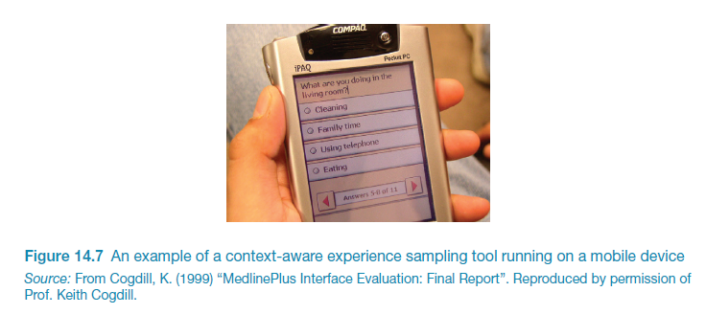
Technology for context-aware field data collection
Notes:
24

Slide 25
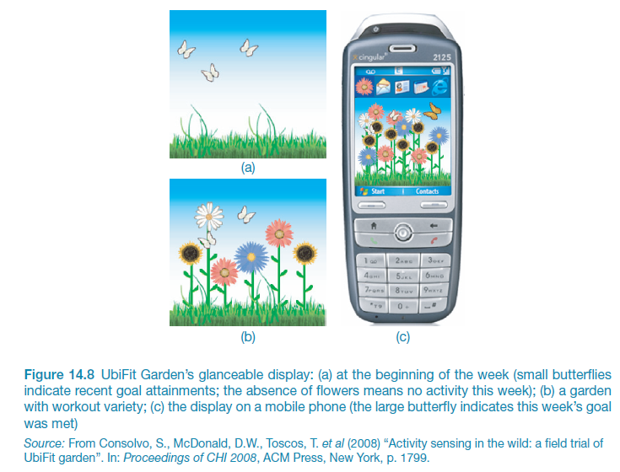
An in-the-wild study: UbiFit Garden

Slide 26
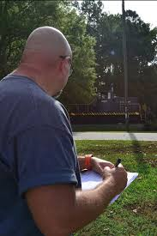
Data collection & analysis
Observation & interviews
Notes, pictures, recordings
Video
Logging
Analyzes
Categorized
Categories can be provided by theory
Grounded theory
Activity theory
Notes:
26

Slide 27
A field study of a pain-monitoring device
Monitoring patients’ pain is a known challenge for physicians
Goal of the study was to evaluate the use of a pain-monitoring device for use after ambulatory surgery
Painpad was a keypad device
It was usability tested extensively in the lab before being taken into two hospitals.
Aim was to understand how painpad was used in the natural environment and routines in two UK hospitals.
How pain-monitoring with painpad differed from
Notes:
27

Slide 28
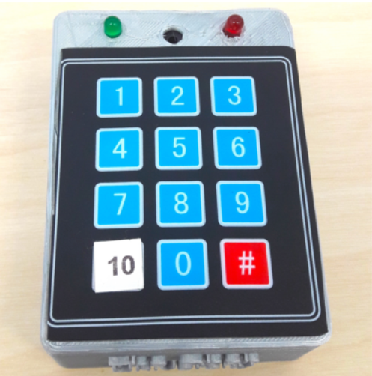
Painpad
A tangible device for inpatient self-logging of pain
Source: Price et al., 2018. Reproduced with permission of ACM Publications

Slide 29
Data collection & participants
Two studies in two hospitals involving 54 people
13 males, 41 females
Privacy was a important concern
Hospital stay ranged from 1-7 days, mean and median age 64.6, 64.5
Given painpad after surgery and prompted to report pain levels every two hours
Nurses also collected scores
All data entered into charts
Patients of one hospital were given a user-satisfaction survey when the left
Also rated painpad on a 1-5 Likert scale
Notes:
29

Slide 30
Data analysis & presentation
Three types of data were collected:
Satisfaction with painpad based on questionnaire responses,
Patients’ compliance with the two-hour routine,
How data collected from painpad compared with data collected by nurses.
Data showed:
Satisfaction with painpad 4.63 on Likert scale;
Patience compliance was mixed, some liked others disliked or didn’t notice the prompts;
Patients recorded more scores with Painpad than with the nurses

Slide 31
Data presentation
The aim is to show how the products are being appropriated and integrated into their surroundings.
Typical presentation forms include:
Vignettes,
Excerpts,
Critical incidents,
Patterns, and narratives.

Slide 32
Key points
Usability testing takes place in controlled usability labs or temporary labs.
Usability testing focuses on performance measures, e.g. how long and how many errors are made when completing a set of predefined tasks. Indirect observation (video and keystroke logging), user satisfaction questionnaires and interviews are also collected.
Affordable, remote testing systems are more portable than usability labs. Many also contain mobile eye-tracking and other devices.
Experiments test a hypothesis by manipulating certain variables while keeping others constant.
The experimenter controls independent variable(s) in order to measure dependent variable(s).
Field studies are evaluation studies that are carried out in natural settings to discover how people interact with technology in the real world.
Field studies that involve the deployment of prototypes or technologies in natural settings may also be referred to as ‘in the wild’.
Sometimes the findings of a field study are unexpected, especially for in the wild studies in which explore how novel technologies are used by participants in their own homes, places of work, or outside.
Notes:
32

Slide 33
You should now...
Be able to define what usability testing is
Be able to explain the basics of experimental design
Be able to define field studies
Be able to describe examples of and complications for usability testing in-the-wild

